Slide 1
IP SPOOFING DETECTION FOR NETWORK INTRUSION DETECTION
Instructor: Dr. Coskun Bayrak (UALR) CPSC 7311: Software Engineering
Notes:
Presentation slide for courses, classes, lectures et al.

Slide 2
Information
Internetwork communication
Attacker (Client socket, IP_by_NAT, public_side_ip)
Sender(Client socket, IP_by_NAT, public_side_ip)
Receiver (Server socket, IP_by_NAT, public_side_ip)
Router (Normal Forwarder, Firewall)
Routing Protocol
Interios (OSPF, IS-IS, RIP) – for single routing domain (Single administration)
Exterios (BGP, PVRP) – over internet over anonymous autonomous systems
Communication channel (composed of networking cable (CAT 6), radio signal, switch, access point, router, VSAT, Satellite etc)
Firewall rules
Intrusion Detecting rules
Intrusion Preventing rules
Gateway (What is my IP?)
NAT
TCP datagram
TTL (TIME TO LIVE)
TCP Sequence
TCP port
MTU
IP packet
IP Source address
Destination Address
SYN, ACK, RST flags
IP fragmentation by IP Identification ID
Notes:
Beginning course details and/or books/materials needed for a class/project.

Slide 3
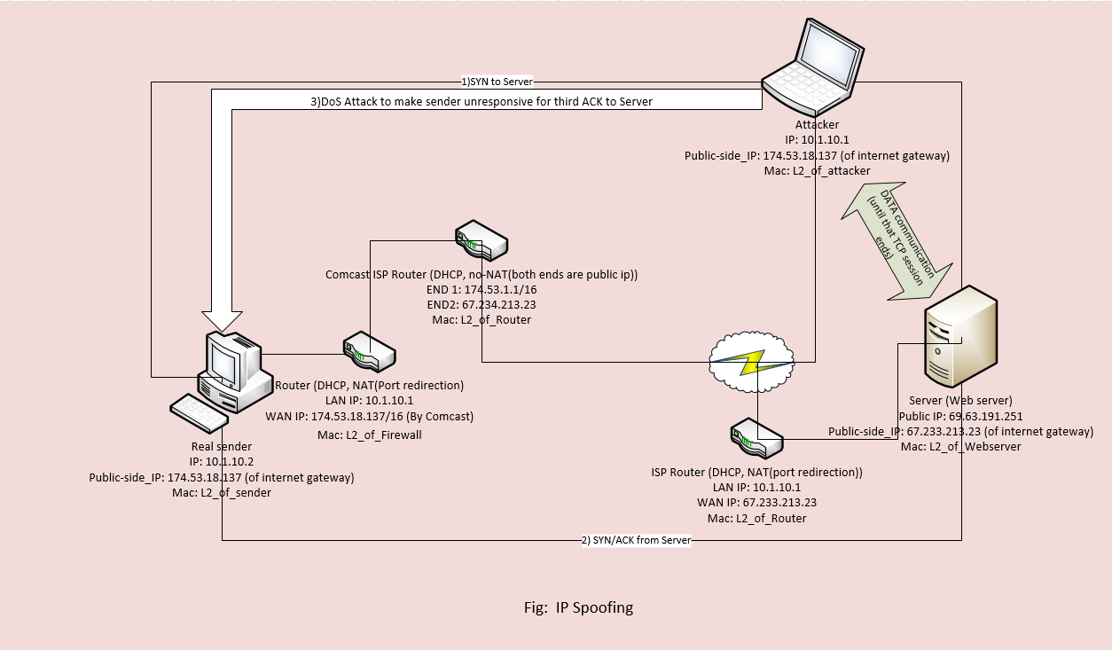
IP Spoofing based on TCP Sequence prediction attack
Notes:
A schedule design for optional periods of time/objectives.

Slide 4
How TCP 3-Way Handshake occurs?
Suppose client machine A wants to talk to server B then It sends the following message:
A->B: SYN, ISNa (Eg, ISNa = 0, |Data| = 0, ACK = 0)
That is, it sends a packet with the SYN ("synchronize sequence number") bit set and an initial sequence number ISNa.
B replies with
B->A: SYN, ISNb, ACK(ISNa) (Eg, B acknowledges A->B signal, so ACK = 1. ISNb = 0, |Data| = 0)
In addition to sending its own initial sequence number, it acknowledges A's. Note that the actual numeric value ISNa must appear in the message.
A concludes the handshake by sending
A->B: ACK(ISNb) (Eg, A knowledges that it’s request is acknowledged by B. So, it sets ACK = 1. Finally, sends to B saying “I have also acknowledged” from you. |Data| = 0 ).
Now, 3 ways TCP-Handshake completes. (Note: Above ISN are relative sequence number. Actually there is original sequence number M generated by Microsoft Timer. Tool like Wire-shark uses relative SEQ to make more user friendly and understandable. )
The initial sequence numbers are intended to be more or less random at first. More precisely, RFC 793 specifies that the 32-bit counter be incremented by 1 in the low-order position about every 4 microseconds. Instead, Berkeley-derived kernels increment it by a constant every second, and by another constant for each new connection. Thus, if you open a connection to a machine, you know to a very high degree of confidence what sequence number it will use for its next connection because there is the pattern of ISN incrementation. And therein lies the attack.
Notes:
A schedule design for optional periods of time/objectives.

Slide 5
How TCP Sequence prediction attack occurs?
The attacker X first opens a real connection to its target B -- say, to the mail port or the TCP echo port. This gives ISNb. It then impersonates A and sends
Ax->B: SYN, ISNx
B's response to X's original SYN
B->A: SYN, ISNb', ACK(ISNx)
goes to the legitimate A. X never sees that message but can send
Ax->B: ACK(ISNb')
Now, B is expecting ISNb‘ from A, which it recives. So it thoughts this is my genuine client A. So, it starts to send data. But the data goes to attacker X.
using the predicted value for ISNb'. If the guess is right -- and usually it will be -- B's server thinks it has a legitimate connection with A, when in fact X is sending the packets. X can't see the output from this session, but it can execute commands as more or less any user -- and in that case, the game is over and X has won. After, if A sees the response from B, it sees B is acknowledging those packets it never sent, it tries to tear down the communication by RST flag ON. But, the attacker’s DoS attack makes A unresponsive. This is why IP Spoofing in this scenario become too much dangerous. For this, strong detection strategy should be implemented to prevent IP Spoofing. How: i) DoS restriction strategy at A – does is seems avoidable? No. ii) Can B be able to know X is different than A? No.
Notes:
A schedule design for optional periods of time/objectives.

Slide 6
How TCP Sequence prediction attack occurs if X already captured packet?
The attacker X first opens a real connection to its target B using A’s captured TCP seq number and it’s crafted packet.
B sends whatever after that to X.
Notes:
A schedule design for optional periods of time/objectives.

Slide 7
How to avoid this attack?
There should be different type of TCP Sequence number implemented in communication. We should put cryptographically secure F there and end point computers use the keys to encode and decode F to know each other. This F allows end-computers to know local_side of IP as well global_side_of_IP. The combination of these two IP makes the computer uniquely distinct in this world.
ISN = M + F(hop_count_upto_first_private_gateway, localhost, localport, remotehost, remoteport). Here, M is the Microsoft timer, F is the function having parameters localhost, localport, remotehost, remoteport and hop count). Here, F should be cryptographically secure function. Both A and B share this F. So, even Attacker (X) captures the whole packets, it can guess M but it can’t decrypt F. So, B never acknowledges X.
Hop_count makes the private network computer unique. And we assume, inside private network there is static routing protocol. Static routing means the route to the destination is always the same.
If there is OSPF configured inside private network, then it can change routing path. In this case hop_count doesn’t work. Generally, we assume, there are no hackers inside our network.

Slide 8
How to avoid this attack?
ISN = M + F(hop_count_upto_first_private_gateway, localhost, localport, remotehost, remoteport).
The M (sequence number generated by Microsoft Timer) part, we can’t change, even we can’t encrypt only M part. The client on either side of a TCP session maintains M (a 32-bit sequence number) it uses to keep track of how much data it has sent. This sequence number is included on each transmitted packet, and acknowledged by the opposite host as an acknowledgement number to inform the sending host that the transmitted data was received successfully.

Slide 9
How client and server shares secure communication?
They agree in their own crafted TCP sequence number. Sends that securely. Encrypt and decrypt using same shared key.
When the attacker captures the packets it can know M part only, it can’t decrypt F part. So, it can’t guess the sequence number that server is expecting from its genuine client.

Slide 10
Some of my snapshots

Slide 11
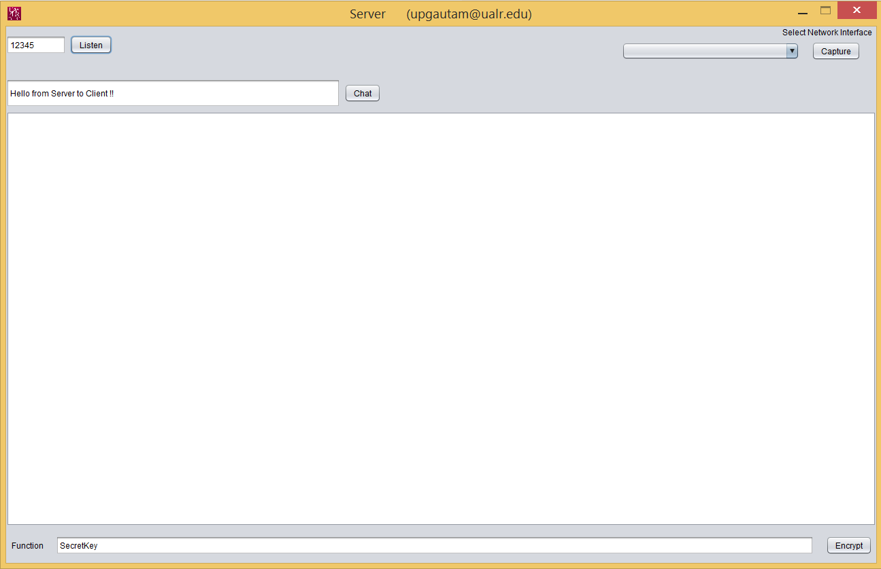
Server-side
Server opens its port by clicking to listen button.

Slide 12
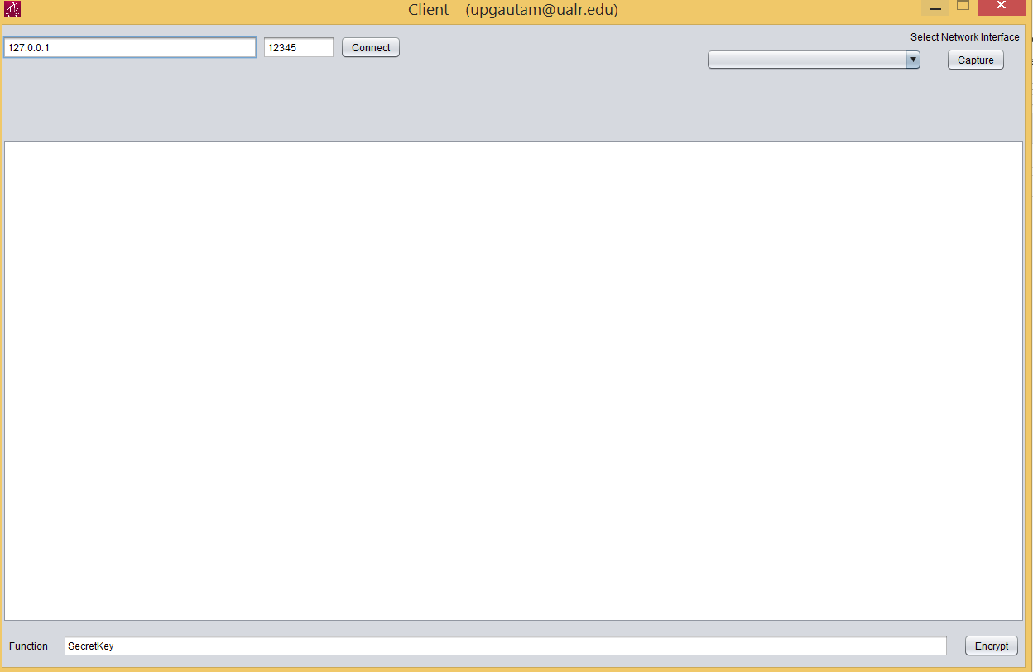
Client-side
Clients connects to the server by click to connect.

Slide 13
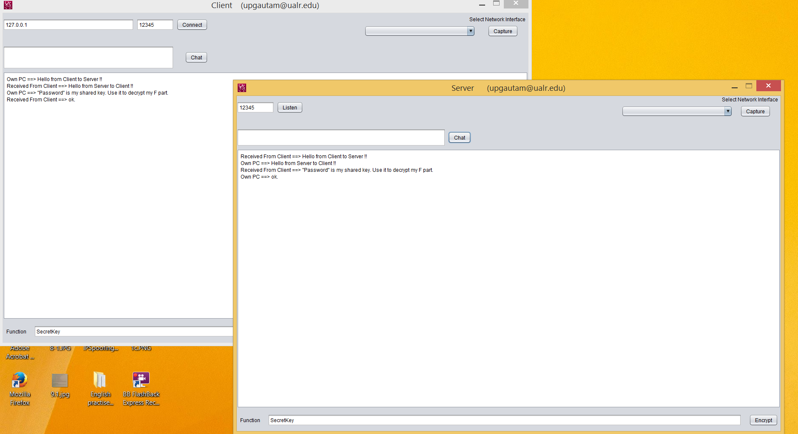
Communication between server and client to share a shared key

Slide 14
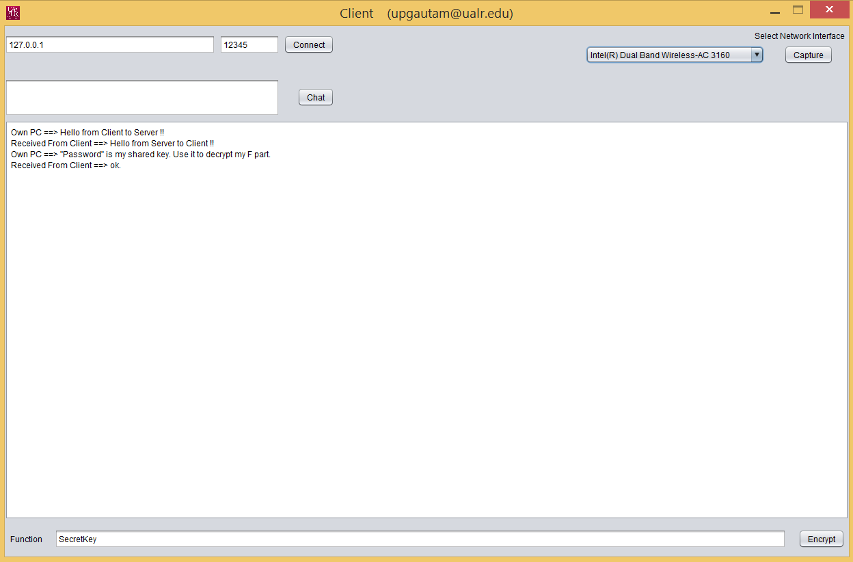
Capture packets by selecting network interface (both can do this)

Slide 15
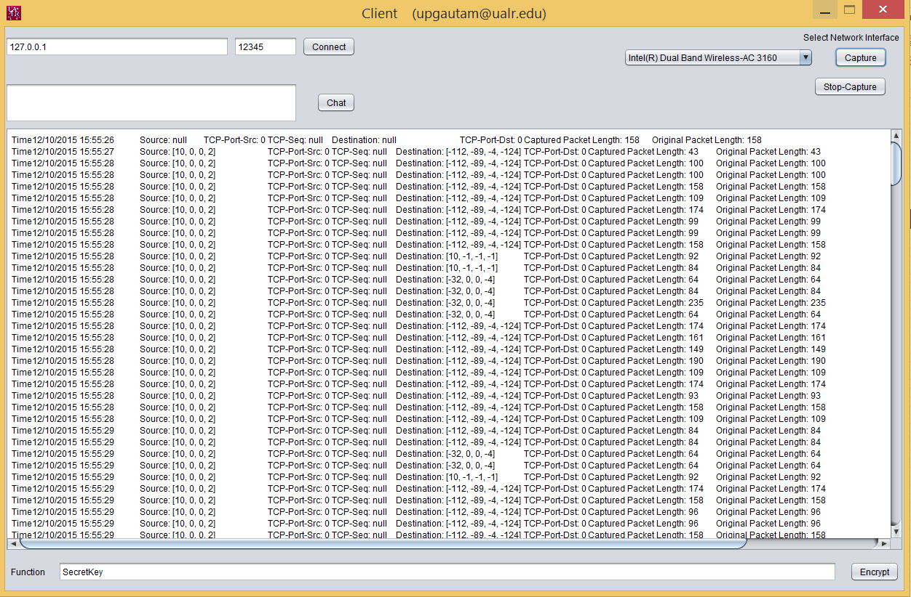

Slide 16
Now, what happens, when attacker captures either packets (from client to server or server to client. Here, even attacker can be DNS server, or Router). It can see only M (original TCP sequence number) But, can’t see the added part F(hop_count, localIP,localport, publicIP, publicPort). So, it can’t guess.
So, whatever it guesses and sends to server, the server doesn’t response to attacker.

Slide 17
Conclusion
This is something like change in TCP or standard network protocol. So, this is not only for product/output orientated we can compare and say I have these much features than theirs and my product is best. This is the research on which networking procedures depends. This is the framework. There are already done things like: TCPCRYPT, TLS (VPN can also work as transport layer security TLS/SSL), Datagram layer security by Cisco AnyConnect VPN, OpenConnect VPN, IPSec etc. But, there may not be IPSecs enables router and computer, consumes time to the both ends for encryption and decryption of whole packets. There may not be VPN software installed. My project very strongly encrypts only F part to exchange messages in communication channel, so this will be very effective.
Notes:
Conclusion to course, lecture, et al.

Slide 18
Questions?
Notes:
Conclusion to course, lecture, et al.

